Slide 1
PSPICE Tutorial
Spring 2015
ECE 255
Instructor: Prof. Alexander Kildishev & Babak Ziaie
TA: Minsuk Koo
PURDUE UNIVERSITY

Slide 2
Contents
Introduction
Installation & Settings
Adding Library
Creating Circuit Schematic
Example:
  DC Sweep
  Bias Point
  AC Analysis
  Transient Analysis
  Half Wave Rectifier

Slide 3

Introduction
Simulation Program for Integrated Circuits Emphasis
PSPICE : A ‘SPICE’ version by Cadence
Simulates electronic circuits’ behavior on computer using the ‘model file’ of that component
Makes circuit solving much easier
  Faster and accurate

Slide 4
Installation
Download free demo software from the link: http://www.cadence.com/products/orcad/pages/downloads_verify.aspx
Register with a valid email address
Click the link in confirmation e-mail and download:
OrCAD 16.6 Demo Software (Capture and PSpice only) [ Download - 16.6 ]
Enter details below if asked:
  Job Function: Professor/Teacher/Student
  Job Title: Student
  Technology Interest: Analog/Mixed-Signal Design, Logic Design
Install in your directory of choice and start

Slide 5
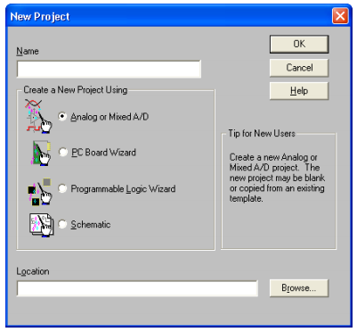
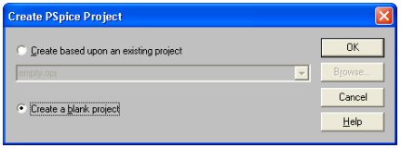
Invoking PSpice
Double Click: “OrCAD Capture CIS” shortcut on your desktop
Click: File => New => Project
Name your Project (say demo), Select “Analog or Mixed A/D” and click OK
Select “Create a blank project” and click OK

Slide 6
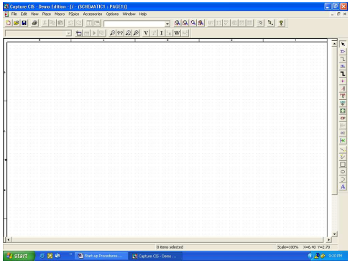
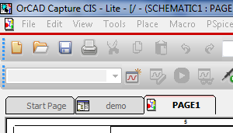
Schematic Screen
Next a blank schematic screen will open. This is the place where we’ll build the schematic for our circuit.
A component library (which contains components) needs to be added now.
Notice the three tabs on the top. Click the one with your project name (demo here)

Slide 7
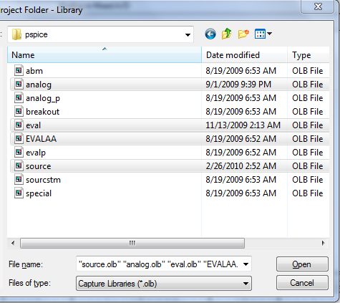
Adding Library – (1)
Opening the Project Page (demo), you’ll find a library folder there
Right click and choose “Add File”
New pop up window opens capture folder
Browse: library => PSpice
Select: “analog”, “eval”, “EVALAA” and “source” using Ctrl key and click open

Slide 8
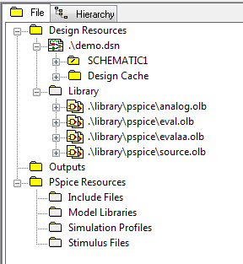
Adding Library – (2)
Now the added libraries are displayed in the Library Folder
Use Ctrl + S to save the settings and click on the “Page 1” tab to begin with your circuit schematic

Slide 9
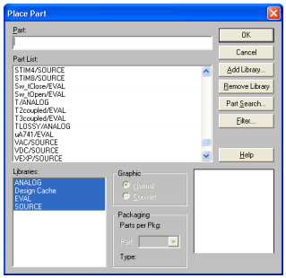
Creating Circuit Schematic
Click Place=> Part in the menu bar or click on the special symbol (IC with + sign) to add a component
All circuit components available in the highlighted library are displayed
Search or scroll to select and place the component
Right click on the component for additional options (like rotate/flip)
Select and double click to change values

Slide 10
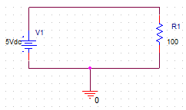
Example
Creating a simple resistor circuit
Search and select “resistor” (an ideal resistor) available in the EVALAA library.
Double click and it appears in the schematic. Place.
Double click the value to set value (100 ohm). Right click to rotate
Similarly select Vdc from source library. Double click to set 5Vdc

Slide 11
Example (contd.)
Now select “place wire” from the right pane and use cross-hairs to connect nodes.
Next select ground symbol from the right pane and place it as shown the figure earlier. Select 0/SOURCE when asked for.
This completes out circuit schematic
Now we’ll simulate our circuit

Slide 12
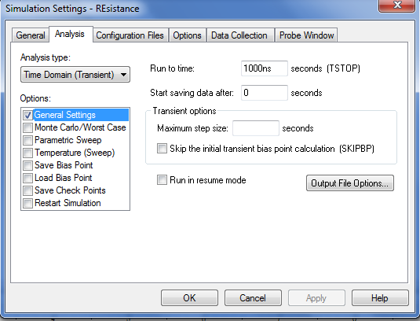
Example (contd.)
Go to the PSpice tab use “New” button (left, 3rd row from top), and create a New Simulation Profile. Give it a name (say resistance).
A new pop-up window
will appear
(Use “Edit Simulation
Profile” next to it to edit)

Slide 13
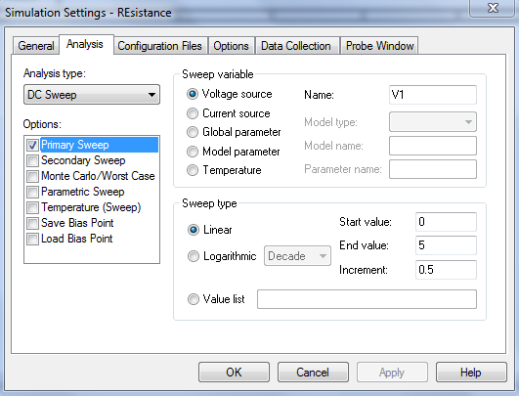
Example (contd.)
Set analysis type: “DC Sweep”
Select the voltage source to be swept
Give the range
E.g.: we put
  Voltage source: V1
  Sweep type: Linear
  Start Value: 0V
  Stop Value: 5V
  Step: 0.5V
Click OK

Slide 14
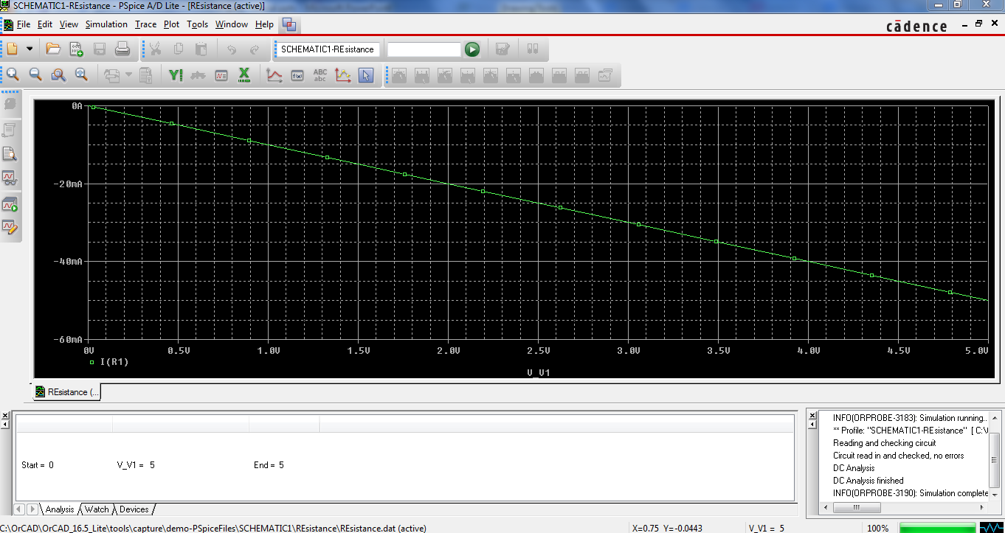
Example (contd.)
Use the RUN button in the toolbar shown above to run spice
Now use “Voltage probe” labeled V to probe a Voltage node (wire) and use the “Current Probe” to probe current at a node (junction of wire and a component)
The results are displayed in the PSpice A/D Lite window which pops up.
Play around with other
options in the output and
explore

Slide 15
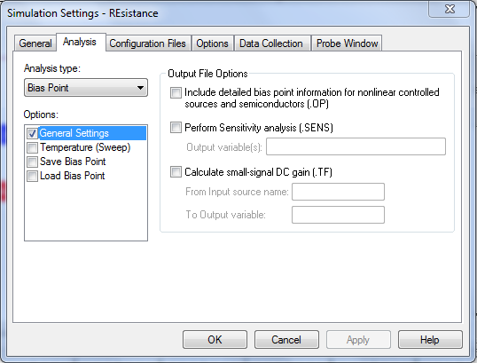
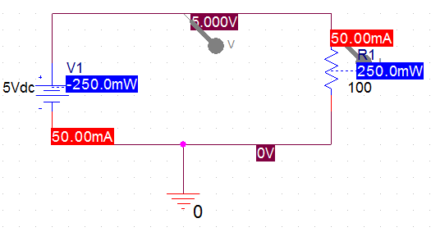
Example: DC bias point
In a similar fashion just select “Bias Point” in Analysis type and run spice.
It outputs all the current and voltage values in the DC simulations

Slide 16
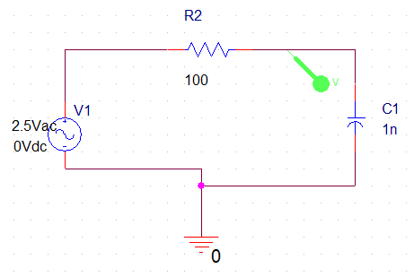
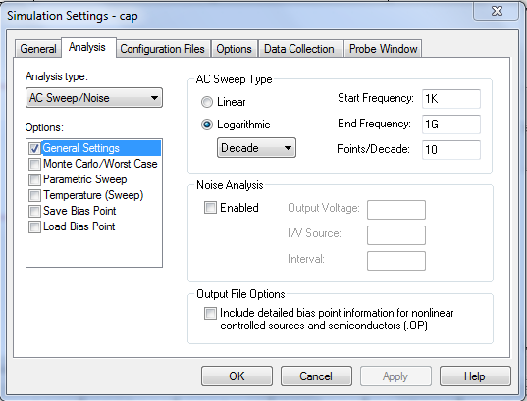
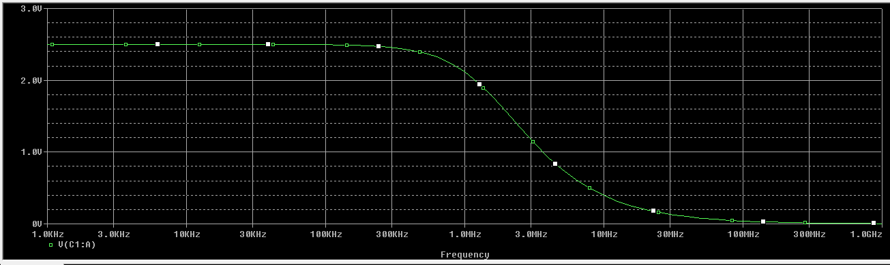
Other Simulation types
AC simulation
  Used when simulating an AC signal
  AC sine wave is applied at input
  Analysis done in frequency domain

Slide 17
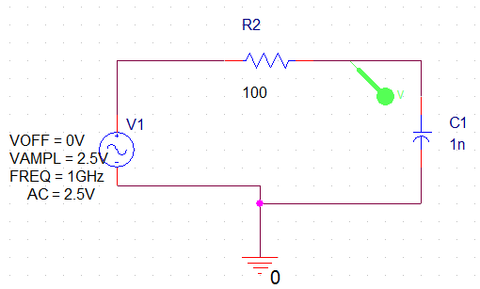
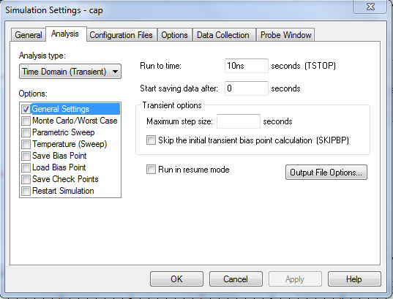
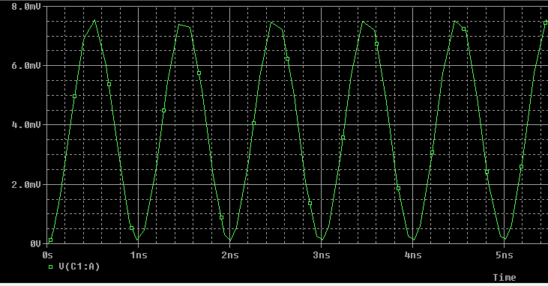
Other Simulation types
Transient Signal
  When dealing with signals in time domain
  Analysis done in time domain
  Signals plotted with increasing time

Slide 18
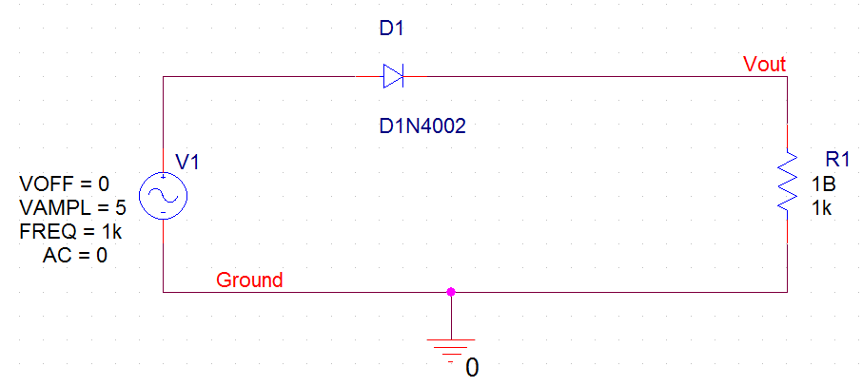
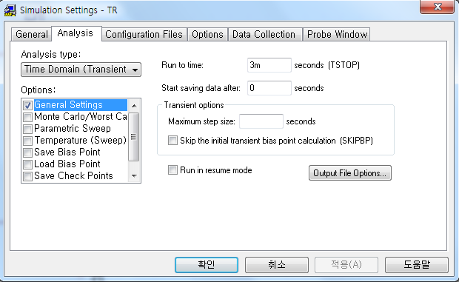
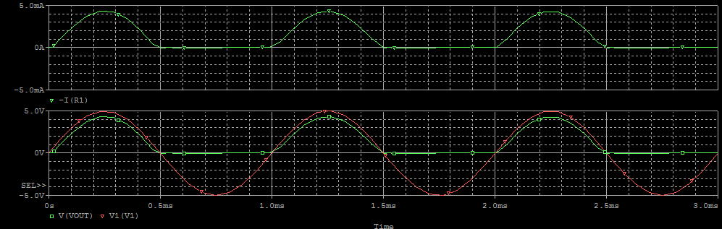
Half Wave Rectifier Example
Transient Signal
  Net name (N) – Vout, Ground
  Set your simulation time properly
  Use probes to see the outputs
  or “Add trace” on the plot

Slide 19

Questions !!

